Slide 1

Data Mining
Computer Science & Engineering, Khulna University
Introduction
Dr. Amit Kumar Mondal,
Associate Professor, CSE KU

Slide 2
Book Reference
Data Mining Concepts and Techniques Third Edition Jiawei Han University of Illinois at Urbana–Champaign Micheline Kamber Jian Pei Simon Fraser University

Slide 3
Who knows better about most of the people in the world??
Google’s Flu Trends uses specific search terms as indicators of flu activity. It found a close relationship between the number of people who search for flu-related information and the number of people who actually have flu symptoms.
A pattern emerges when all of the search queries related to flu are aggregated. Using aggregated Google search data, Flu Trends can estimate flu activity up to two weeks faster than traditional systems can.

Slide 4




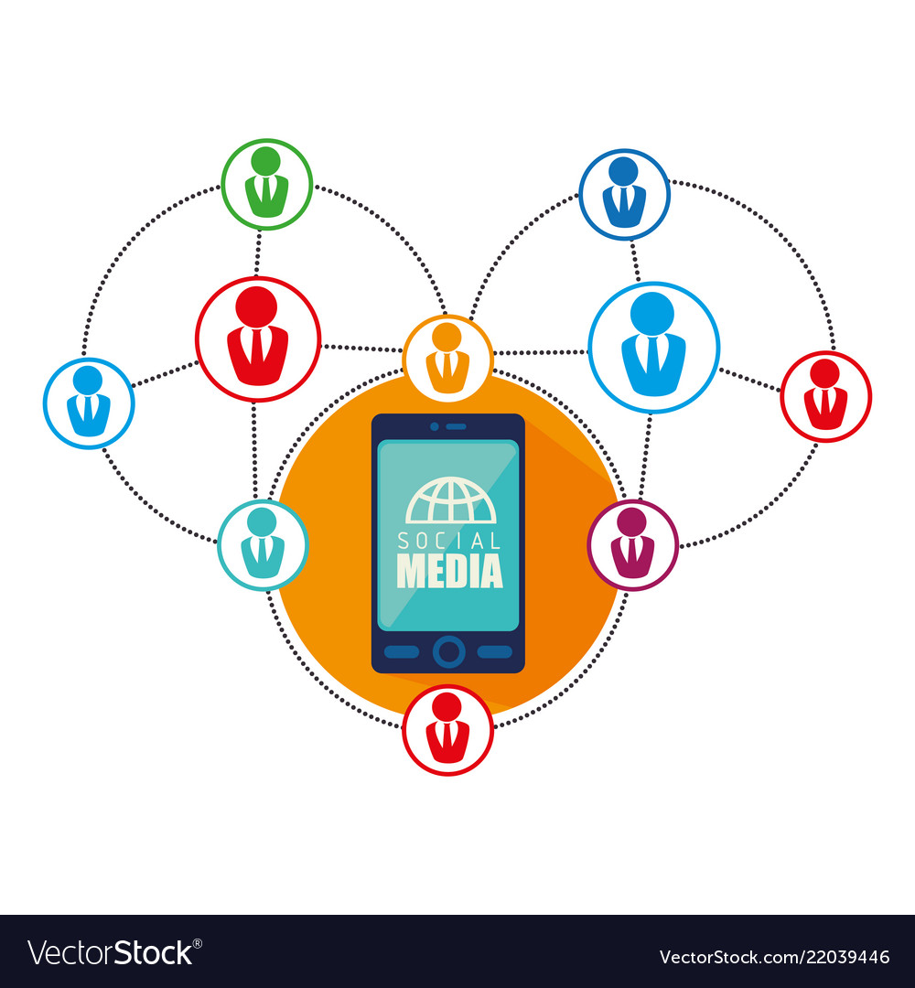

Data Sources
medical and health industry
telecommunication networks
Businesses
science and engineering
social media
World Wide Web

Slide 5
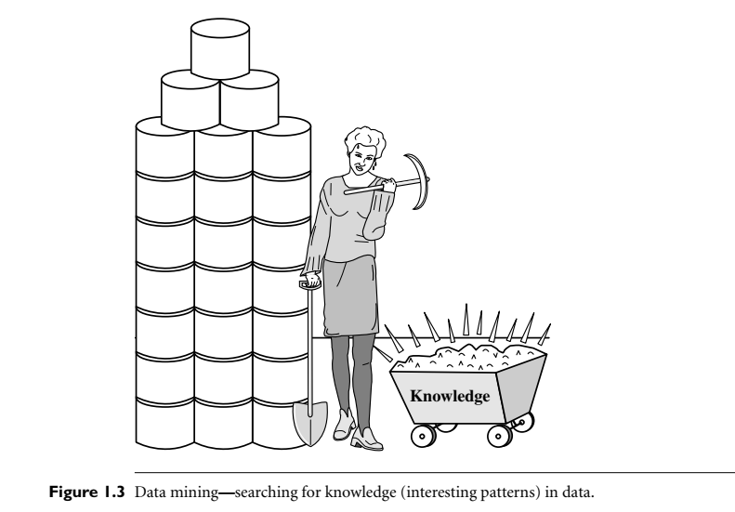
Data Mining
Data Mining is the process of discovering patterns and relationships in large data sets, acting like a detective analyzing data to uncover hidden mysteries.
It combines statistics, artificial intelligence (AI), and machine learning to identify hidden trends and patterns
Knowledge mining from data

Slide 6
Data Mining
Data mining
Extraction of interesting patterns or knowledge from huge amount of data -- (non-trivial, implicit, previously unknown and potentially useful)
Alternative names
Knowledge discovery (mining) in databases (KDD), knowledge extraction, data/pattern analysis, data archeology, data dredging, information harvesting, business intelligence, etc.
Watch out: Is everything “data mining”?
Simple search and query processing
(Deductive) expert systems

Slide 7
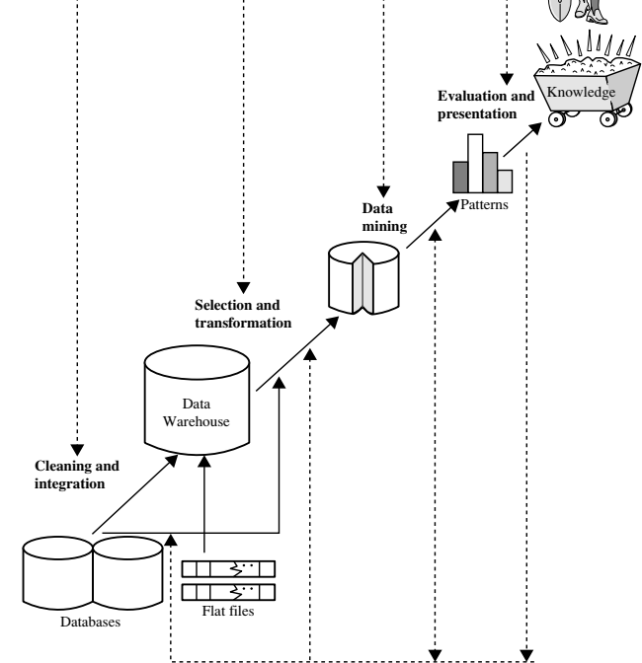
Data Mining Steps

Slide 8
Data Mining Steps
Data cleaning – remove noisy and inconsistent data
Data integration from multiple sources -- where multiple data sources may be combined
Data selection for data mining -- data relevant to the analysis task are retrieved from the database
Data transformation -- data are transformed and consolidated into forms appropriate for mining by performing summary or aggregation operations

Slide 9
Data Mining Steps
Data mining -- an essential process where intelligent methods are applied to extract data patterns
Pattern evaluation -- identify the truly interesting patterns representing knowledge based on interestingness measure
Knowledge presentation -- visualization and knowledge representation techniques are used to present mined knowledge to users

Slide 10
Data Mining: On What Kinds of Data?
Database-oriented data sets and applications
Relational database, data warehouse, transactional database
Advanced data sets and advanced applications
Data streams and sensor data – cctv video
Time-series data, temporal data, sequence data (incl. bio-sequences)
Structure data, graphs, social networks and multi-linked data
Object-relational databases
Heterogeneous databases and legacy databases
Spatial data and spatiotemporal data - maps
Multimedia database
Text databases
The World-Wide Web

Slide 11
Data Mining: On What to be Mined?
Concept description: Characterization and discrimination
Mining Frequent Patterns, Associations, and Correlations
Classification and Regression for Predictive Analysis
Cluster Analysis
Outlier Analysis
Are All Patterns Interesting?

Slide 12
Data Mining: Concept description: Characterization and discrimination
Useful to describe individual classes and concepts in summarized, concise, and yet precise terms--- classes of items for sale include computers and printers, and concepts of customers include bigSpenders
Data characterization - a summarization of the general characteristics or features of a target class of data.
the user-specified class are typically collected by a query. -- software products with sales that increased by 10% in the previous year.
The output of data characterization -- pie charts, bar charts, curves, multidimensional data cubes, and multidimensional tables
Data discrimination -- comparison of the general features of the target class data objects against that of objects from one or multiple contrasting classes.
The target and contrasting classes can be specified by a user, and data objects can be retrieved through database queries

Slide 13
Data Mining: Mining Frequent Patterns, Associations, and Correlations ?
Frequent patterns, -- patterns that occur frequently in data.
Kinds of frequent patterns-- frequent itemsets, frequent subsequences and frequent substructures.
Frequent itemset -- refers to a set of items that often appear together in a transactional data, milk and bread, which are frequently bought together in grocery stores by many customers.
A frequently occurring subsequence, -- customers, tend to purchase first a laptop, followed by a digital camera, and then a memory card, is a (frequent) sequential pattern.
A frequent substructure -- refer to different structural forms (e.g., graphs, trees, or lattices) that may be combined with itemsets or subsequences. - (frequent) structured pattern.
Frequent patterns leads to the discovery of interesting associations and correlations within data.

Slide 14
Data Mining: Classification and Regression for Predictive Analysis ?
Classification -- process of finding a model (or function) that describes and distinguishes data classes or concepts.
The model are derived based on the analysis of a set of training data. It is used to predict the class label of objects for which the class label is unknown .
Prediction refers to both numeric prediction and class label prediction.
Regression is used to predict missing or unavailable numerical data values rather than (discrete) class labels.
a statistical methodology that is most often used for numeric prediction, although other methods exist as well. -- identification of distribution trends based on the available data.

Slide 15
Data Mining: Cluster Analysis?
Clustering analyzes data objects without consulting class labels. class labeled data may simply not exist at the beginning.
Clustering can be used to generate class labels for a group of data.
clustered or grouped based on the principle of maximizing the intraclass similarity and minimizing the interclass similarity.
clusters of objects are formed -- objects within a cluster have high similarity in comparison to one another, but are rather dissimilar to objects in other clusters.
Each cluster can be viewed as a class of objects, from which rules can be derived.
Clustering can also facilitate taxonomy formation.

Slide 16
Data Mining: Outlier Analysis?
A data set may contain objects that do not comply with the general behavior or model of the data. These data objects are outliers.
Many data mining methods discard outliers as noise or exceptions. -- in some applications the rare events can be more interesting than the more regularly occurring ones.
detected using statistical tests that assume a distribution or probability model for the data, or using distance measures where objects that are remote from any other cluster are considered outliers.
Density-based methods may identify outliers in a local region

Slide 17
Data Mining: Are All Patterns Interesting?
A data mining system has the potential to generate thousands or even millions of patterns, or rules.
“Are all of the patterns interesting?” Typically, the answer is no—only a small fraction of the patterns potentially generated would actually be of interest to a given user.
“What makes a pattern interesting? Can a data mining system generate all of the interesting patterns? Or, Can the system generate only the interesting ones?”
A pattern is interesting if it is (1) easily understood by humans, (2) valid on new or test data with some degree of certainty, (3) potentially useful, and (4) novel.
A pattern is also interesting if it validates a hypothesis that the user sought to confirm. An interesting pattern represents knowledge.

